Slide 2
6040 Data Mining Applications
R Tutorial

Slide 3
library(dplyr) library(tidyr) library(DMwR)

Slide 4
Outline
dplyr tutorial
tidyr tutorial
Data pre-processing, exploratory data analysis, and predictive model construction tutorial (third video)

Slide 5
library(dplyr)
What is dplyr?
dplyr is a powerful R-package to transform and summarize tabular data with rows and columns.
Why is it useful?
The package contains a set of functions (or “verbs”) that perform common data manipulation operations such as filtering for rows, selecting specific columns, re-ordering rows, adding new columns and summarizing data.

Slide 6
Install and Load
How do I get dplyr?
install.packages("dplyr")
To load dplyr
library(dplyr)

Slide 7
Data: mammals sleep
The msleep (mammals sleep) data set contains the sleeptimes and weights for a set of mammals and is available in the dagdata repository on github. This data set contains 83 rows and 11 variables.
Download the msleep data set in CSV format from here and then load into R:
https://raw.githubusercontent.com/genomicsclass/dagdata/master/inst/extdata/msleep_ggplot2.csv
Notes:
1-6

Slide 8
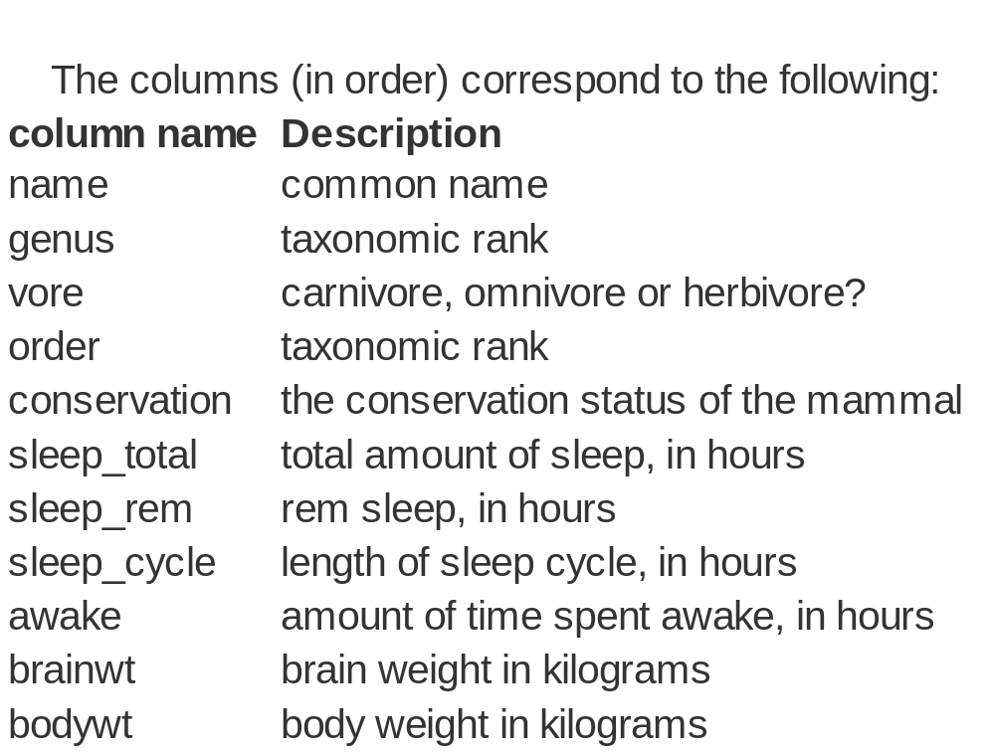

Slide 9
Important dplyr verbs to remember
dplyr verbs | Description
select() | select columns
filter() | filter rows
arrange() | re-order or arrange rows
mutate() | create new columns
summarise() | summarise values
group_by() | allows for group operations in the “split-apply-combine” concept

Slide 10
Selecting columns using select()
Select a set of columns: the name and the sleep_total columns.
sleepData <- select(msleep, name, sleep_total) head(sleepData)
Notes:
9

Slide 11
Selecting columns using select()
To select all the columns except a specific column, use the “-“ (subtraction) operator (also known as negative indexing)
head(select(msleep, -name))
Notes:
13

Slide 12
Selecting columns using select()
To select a range of columns by name, use the “:” (colon) operator
head(select(msleep, name:order))
Notes:
16

Slide 13
Selecting columns using select()
To select all columns that start with the character string “sl”, use the function starts_with()
head(select(msleep, starts_with("sl")))
Notes:
19

Slide 14
Some additional options to select columns based on a specific criteria include
ends_with() = Select columns that end with a character string
contains() = Select columns that contain a character string
matches() = Select columns that match a regular expression
one_of() = Select columns names that are from a group of names

Slide 15
Selecting rows using filter()
Filter the rows for mammals that sleep a total of more than 16 hours.
filter(msleep, sleep_total >= 16)
Notes:
22

Slide 16
Selecting columns using select()
Filter the rows for mammals that sleep a total of more than 16 hours and have a body weight of greater than 1 kilogram.
filter(msleep, sleep_total >= 16, bodywt >= 1)
Notes:
25

Slide 17
Selecting columns using select()
Filter the rows for mammals in the Perissodactyla and Primates taxonomic order
filter(msleep, order %in% c("Perissodactyla", "Primates"))
Notes:
28

Slide 18
Pipe operator: %>%
Here’s an example you have seen:
head(select(msleep, name, sleep_total))
msleep %>% select(name, sleep_total) %>% head

Slide 19
dplyr verbs in action
To arrange (or re-order) rows by a particular column such as the taxonomic order, list the name of the column you want to arrange the rows by
filter(msleep, order %in% c("Perissodactyla", "Primates"))

Slide 20
dplyr verbs in action
Now, we will select three columns from msleep, arrange the rows by the taxonomic order and then arrange the rows by sleep_total. Finally show the head of the final data frame
msleep %>% select(name, order, sleep_total) %>% arrange(order, sleep_total) %>% head
Notes:
42

Slide 21
dplyr verbs in action
Same as above, except here we filter the rows for mammals that sleep for 16 or more hours instead of showing the head of the final data frame
msleep %>% select(name, order, sleep_total) %>% arrange(order, sleep_total) %>% filter(sleep_total >= 16)
Notes:
48

Slide 22
dplyr verbs in action
Something slightly more complicated: same as above, except arrange the rows in the sleep_total column in a descending order. For this, use the function desc()
msleep %>% select(name, order, sleep_total) %>% arrange(order, desc(sleep_total)) %>% filter(sleep_total >= 16)
Notes:
54

Slide 23
Create new columns using mutate()
The mutate() function will add new columns to the data frame. Create a new column called rem_proportion which is the ratio of rem sleep to total amount of sleep.
msleep %>% mutate(rem_proportion = sleep_rem / sleep_total) %>% head
Notes:
60

Slide 24
Create summaries of the data frame using summarise()
The summarise() function will create summary statistics for a given column in the data frame such as finding the mean. For example, to compute the average number of hours of sleep, apply the mean() function to the column sleep_total and call the summary value avg_sleep.
msleep %>% summarise(avg_sleep = mean(sleep_total))
Notes:
65

Slide 25
Group operations using group_by()
The group_by() verb is an important function in dplyr. As we mentioned before it’s related to concept of “split-apply-combine”. We literally want to split the data frame by some variable (e.g. taxonomic order), apply a function to the individual data frames and then combine the output.

Slide 26
Group operations using group_by()
msleep %>% group_by(order) %>% summarise(avg_sleep = mean(sleep_total), min_sleep = min(sleep_total), max_sleep = max(sleep_total), total = n())
Notes:
71

Slide 27
library(tidyr)
What is tidyr?
The tidyr package by Hadley Wickham centers on two functions: gather and spread.
Why is it useful?
You can organize tabular data in many ways
Tidy data builds on a premise of data science that data sets contain both values and relationships. Tidy data displays the relationships in a data set as consistently as it displays the values in a data set.

Slide 28
Create Fictional Stock Data
set.seed(1)
stocks <- data.frame(
time = as.Date('2009-01-01') + 0:9,
X = rnorm(50, 20, 1),
Y = rnorm(50, 20, 2),
Z = rnorm(50, 20, 4)
)
stocks

Slide 29
Key-Value-Pair
time X Y Z
1 2009-01-01 20.45019 20.85020 29.23191
2 2009-01-02 19.98144 19.52271 20.42321
3 2009-01-03 19.68193 22.11697 21.82800
4 2009-01-04 19.07064 21.77285 19.69139
5 2009-01-05 18.51254 18.76151 18.66400
6 2009-01-06 18.92481 24.41220 19.86110
7 2009-01-07 21.00003 19.48995 23.15056
8 2009-01-08 19.37873 17.15101 28.30098
9 2009-01-09 18.61557 19.71120 24.10957
10 2009-01-10 21.86929 20.41508 24.83163

Slide 30
Key-Value-Pair
2009-01-01 X 20.45019
2009-01-01 Y 20.85020
2009-01-01 Z 29.23191

Slide 31
Key-Value-Pair
install.packages
library(tidyr)
stocksL <- gather(data = stocks, key = stock, value = price, X, Y, Z)
stocksL

Slide 32
Key-Value-Pair
time stock price
1 2009-01-01 X 20.45019
2 2009-01-02 X 19.98144
3 2009-01-03 X 19.68193
4 2009-01-04 X 19.07064
5 2009-01-05 X 18.51254
6 2009-01-06 X 18.92481
7 2009-01-07 X 21.00003
8 2009-01-08 X 19.37873
9 2009-01-09 X 18.61557
10 2009-01-10 X 21.86929
…

Slide 33
Key-Value-Pair
gather(stocks, stock, price, -time)
gather(stocks, stock, price, X:Z)
head(gather(stocks, stk, pr, -time))
time stk pr
1 2009-01-01 X 19.37355
2 2009-01-02 X 20.18364
3 2009-01-03 X 19.16437
4 2009-01-04 X 21.59528
5 2009-01-05 X 20.32951
6 2009-01-06 X 19.17953

Slide 34
reshape2
install.packages("reshape2") # if not already installed
library(reshape2)
melt(stocks, measure.vars = c("X","Y","Z"), variable.name = "stock", value.name = "price")
time stock price
1 2009-01-01 X 19.37355
2 2009-01-02 X 20.18364
3 2009-01-03 X 19.16437
4 2009-01-04 X 21.59528
...

Slide 35
Wickham defines tidy data as follows:
1. Each variable forms a column.
2. Each observation forms a row.
3. Each type of observational unit forms a table.
Our stocks data is now “tidy”:
1.After reshaping (or gathering, or melting) our data, each variable forms a column. Our three variables are time, stock, and price.
2. Each row is now an observation. Before reshaping our data, each row represented three observations.
3. Our table (or data frame) consists of one type of unit: observations made per company per day

Slide 36
spread
head(stocksL)
time stock price
1 2009-01-01 X 19.37355
2 2009-01-02 X 20.18364
3 2009-01-03 X 19.16437
4 2009-01-04 X 21.59528
5 2009-01-05 X 20.32951
6 2009-01-06 X 19.17953

Slide 37
spread
spread(data = stocksL, key = stock, value = price)
dcast(stocksL, time ~ stock, value.var = "price")
time X Y Z
1 2009-01-01 19.37355 23.02356 23.67591
2 2009-01-02 20.18364 20.77969 23.12855
3 2009-01-03 19.16437 18.75752 20.29826
4 2009-01-04 21.59528 15.57060 12.04259
5 2009-01-05 20.32951 22.24986 22.47930
6 2009-01-06 19.17953 19.91013 19.77549
7 2009-01-07 20.48743 19.96762 19.37682
8 2009-01-08 20.73832 21.88767 14.11699
9 2009-01-09 20.57578 21.64244 18.08740
10 2009-01-10 19.69461 21.18780 21.67177

Slide 38
dcast
dcast(stocksL, time ~ stock, value.var = "price")
time X Y Z
1 2009-01-01 19.37355 23.02356 23.67591
2 2009-01-02 20.18364 20.77969 23.12855
3 2009-01-03 19.16437 18.75752 20.29826
4 2009-01-04 21.59528 15.57060 12.04259
5 2009-01-05 20.32951 22.24986 22.47930
6 2009-01-06 19.17953 19.91013 19.77549
7 2009-01-07 20.48743 19.96762 19.37682
8 2009-01-08 20.73832 21.88767 14.11699
9 2009-01-09 20.57578 21.64244 18.08740
10 2009-01-10 19.69461 21.18780 21.67177

Slide 39
dplyr data pipeline
stocks %>%
gather(stock,price,X:Z)%>%
group_by(stock) %>%
summarise(min = min(price), max = max(price))
stock min max
1 X 19.16437 21.59528
2 Y 15.57060 23.02356
3 Z 12.04259 23.67591

Slide 40
dplyr data pipeline
stocksL <- gather(stocks, stock, price, X, Y, Z)
aggregate(price ~ stock, data = stocksL, function(x)c(min=min(x),max=max(x)))
stock price.min price.max
1 X 19.16437 21.59528
2 Y 15.57060 23.02356
3 Z 12.04259 23.67591

